Slide 1
Class Topic: Machine Learning
Presented by:
Zannatul Mawa Koli
Roll No. : 22023280
Tracking No. : 229673

Slide 2
Outline
What is machine learning?
Different areas of machine learning
Machine learning methods
Training set and test set
Supervised learning
Unsupervised learning
Reinforcement learning
Conclusions

Slide 3
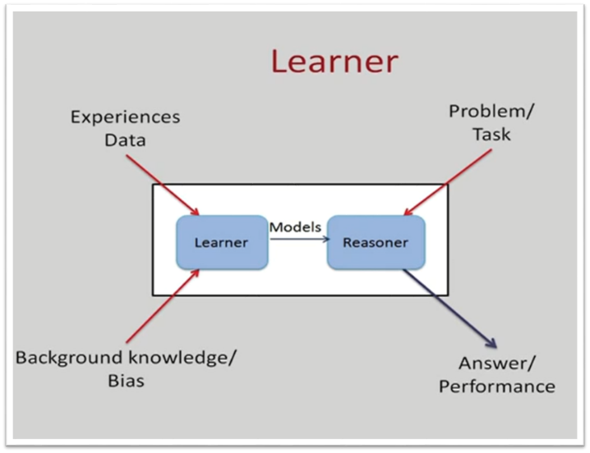
What is machine learning?
Building computer systems that automatically improve with experience.
Learn from data, build models from data and this model can be used for different tasks.

Slide 4
Different areas of machine learning
Web search
Finance
E-commerce
Robotics
Information extraction
Debugging
Computational biology
Image processing and computer vision

Slide 5
Machine learning methods
Supervised learning
Unsupervised learning
Reinforcement learning

Slide 6
Training set and test set
Training set
Used during the learning process.
Supervised learning algorithm looks at the training dataset to determine, or learn, the optimal combinations of variables that will generate a good predictive model.
Test set
Contains the data on which we test the trained and validated model.
Tells us how efficient our overall model is and how likely is it going to predict something.

Slide 7
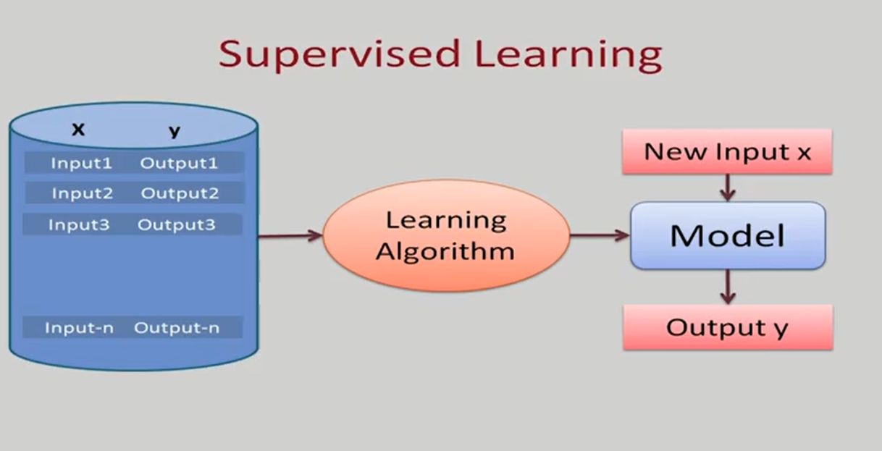
Supervised Learning
Trained on labeled data.
At the end of the training, the algorithm has an idea of how the data works and the relationship between the input and the output.
Example: Linear regression, SVM, KNN etc.

Slide 8
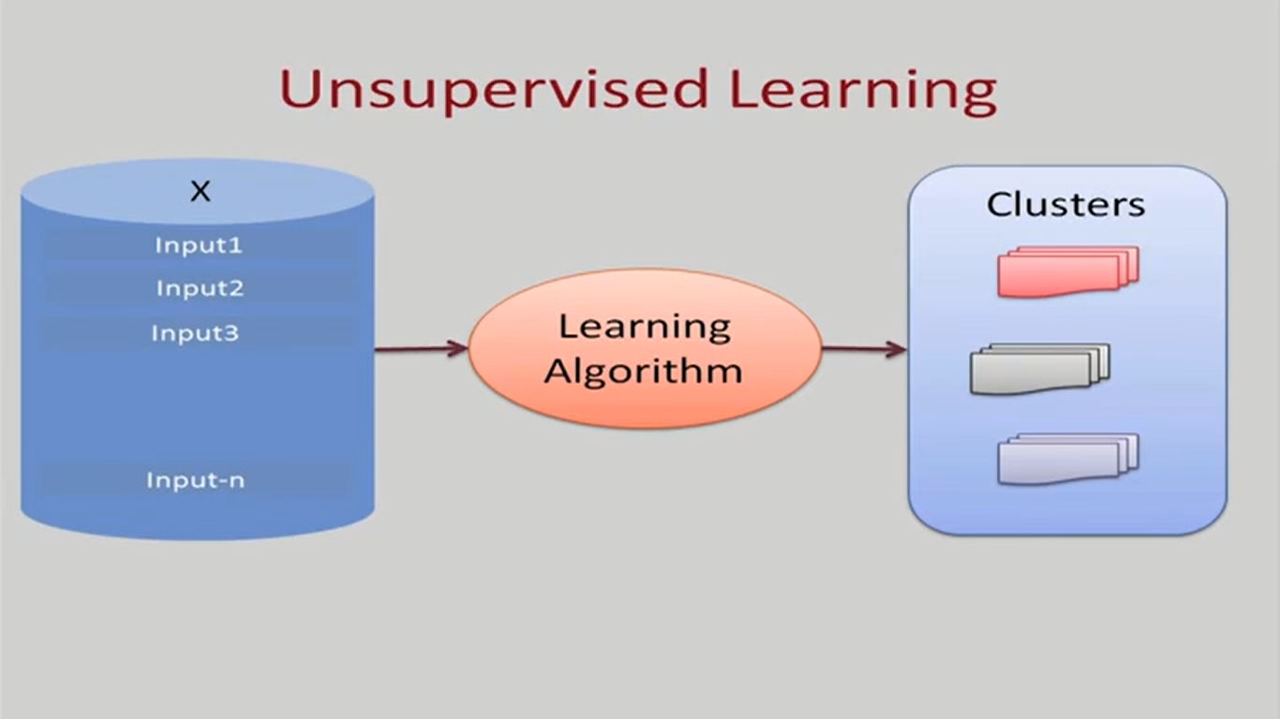
Unsupervised Learning
Work with unlabeled data.
Create structures among the unlabeled data.
Examples: K means, clustering etc.

Slide 9
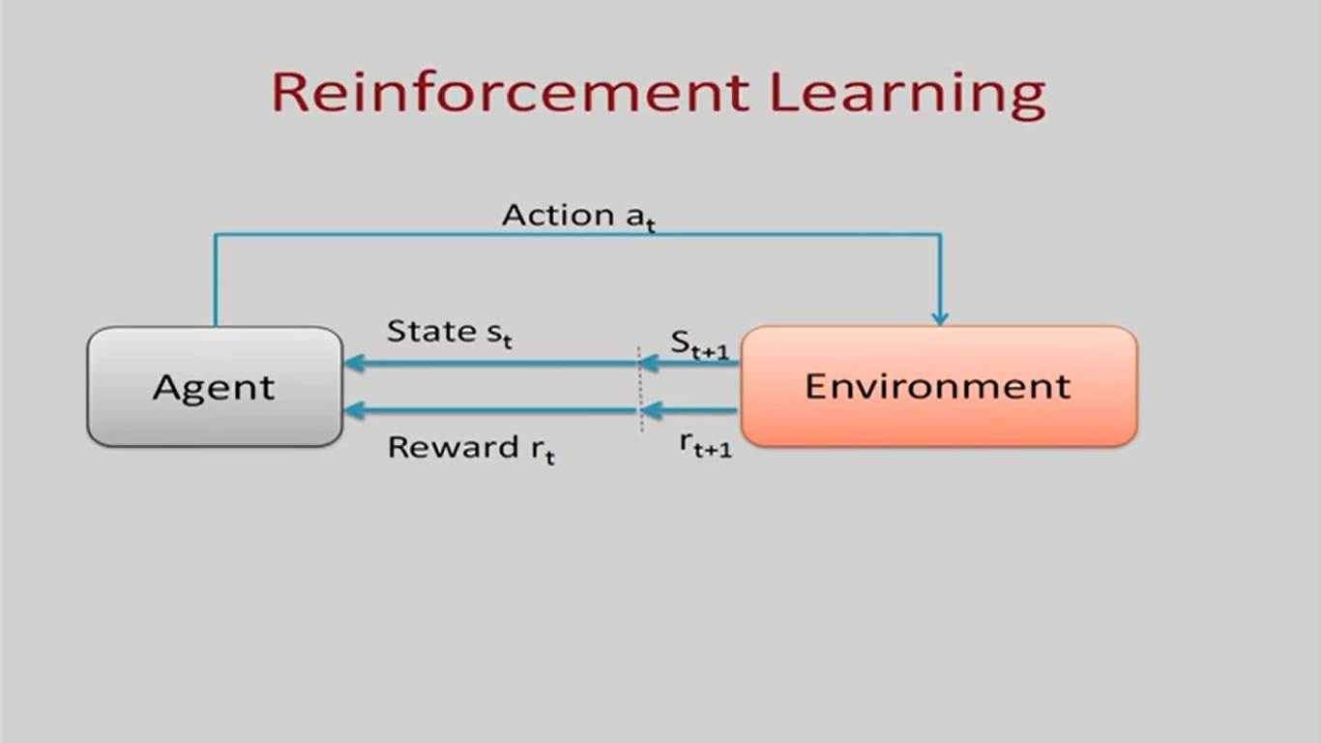
Reinforcement Learning
Feedback based algorithm.
The agent learns by its own experience.
it’s a core part of Artificial intelligence.

Slide 10
Conclusions
Subset of Artificial intelligence.
The goal is to learn from data to provide accurate output.
Mainly concerned about accuracy and patterns.

